Slide 1

Artificial Intelligence for Business Decisions and Transformation
CSCN8030 - Spring 2024 - Section 2
Sprint 1 - Demo
27 May 2024
Group 4 - Members:
Krishna Kumar, Hemasree
Shijin, Jency
Fernandez, Arcadio
Professor:
Glaucia Melo dos Santos, PhD

Slide 2
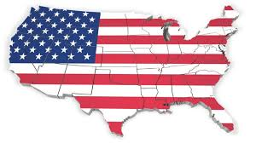

# Project: US Traffic Accident Severity Prediction
US Accidents (2016 - 2023)
A Countrywide Traffic Accident Dataset (2016 - 2023)

Slide 3
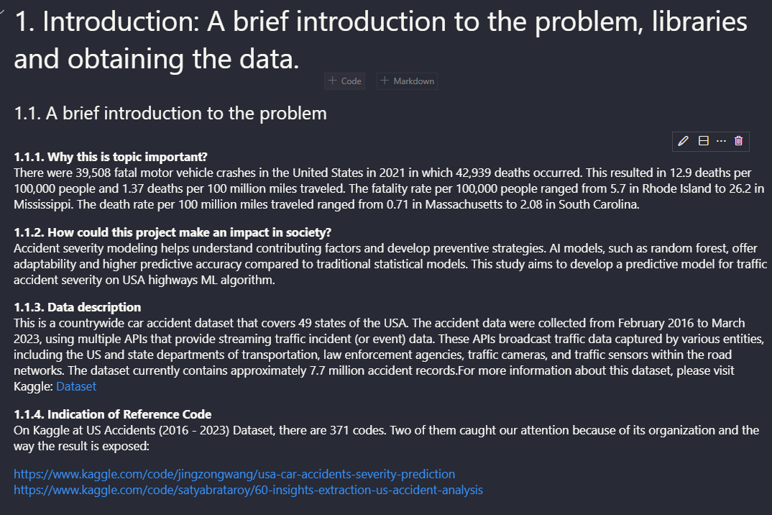

Slide 4
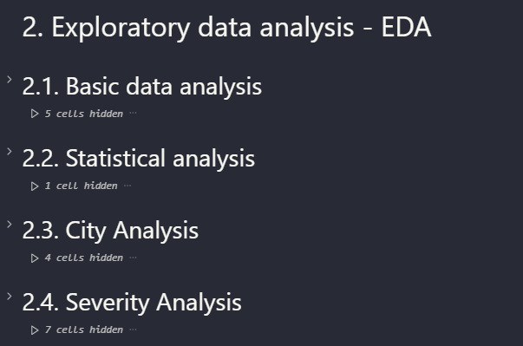

Slide 5
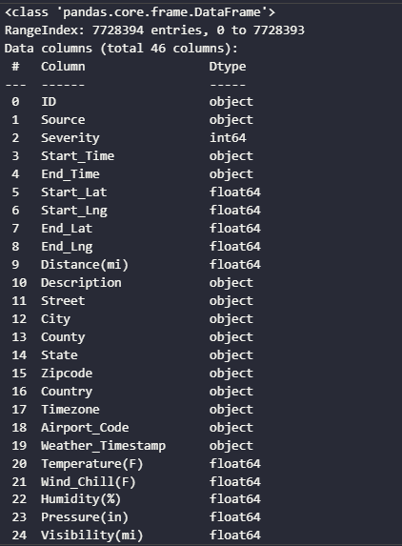
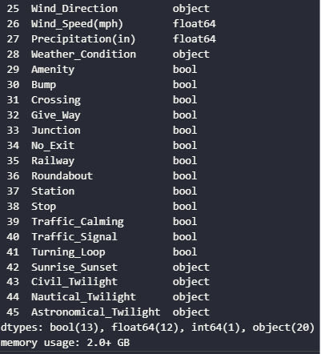

Slide 6
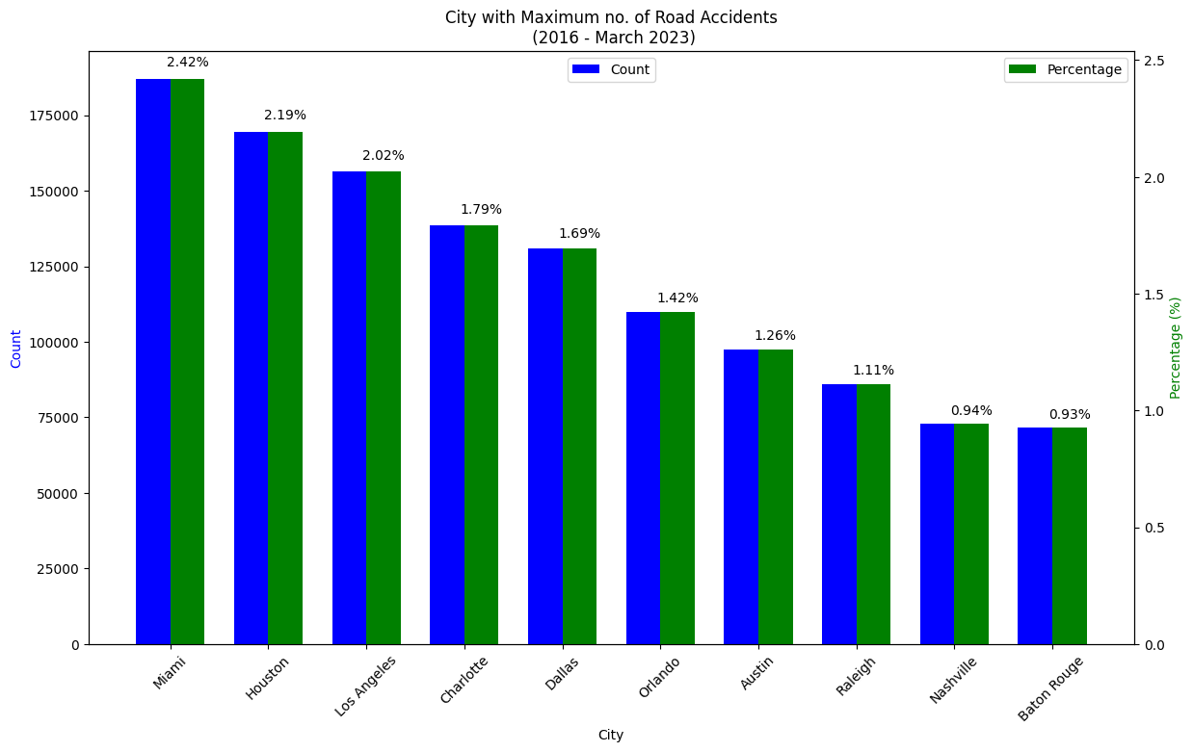
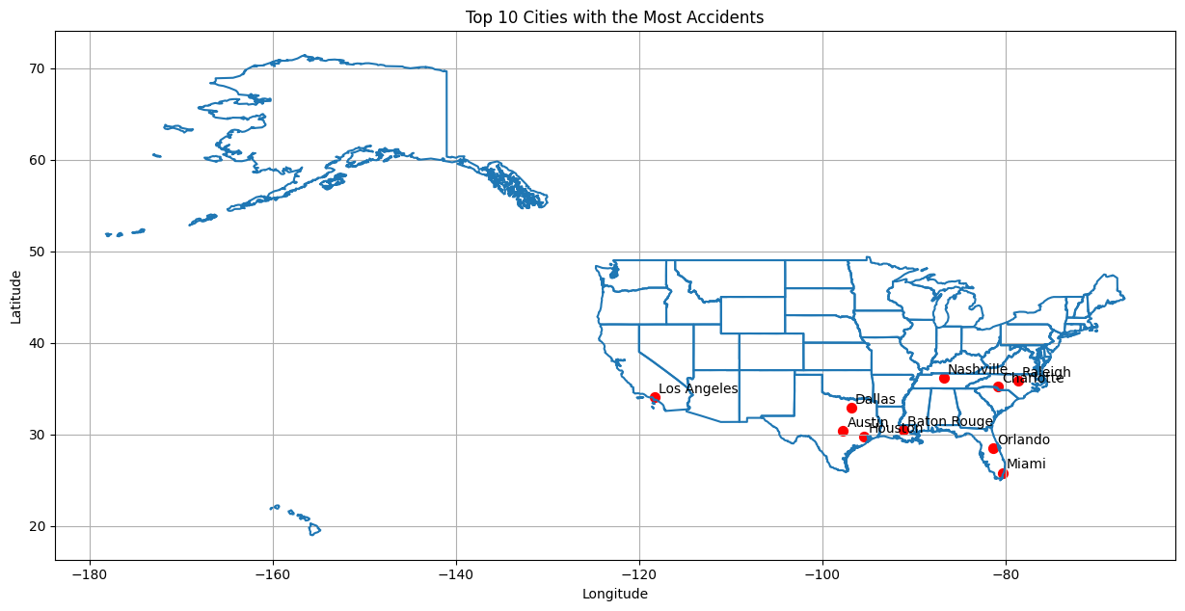

Slide 7
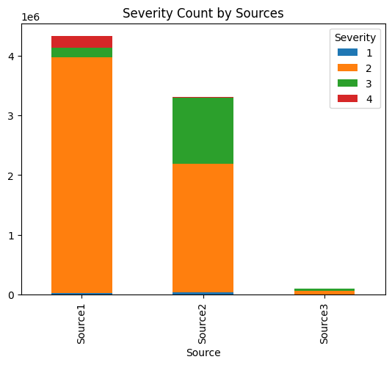
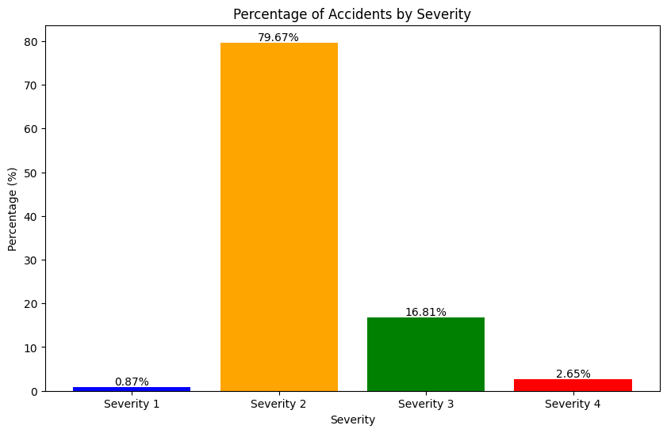

Slide 8
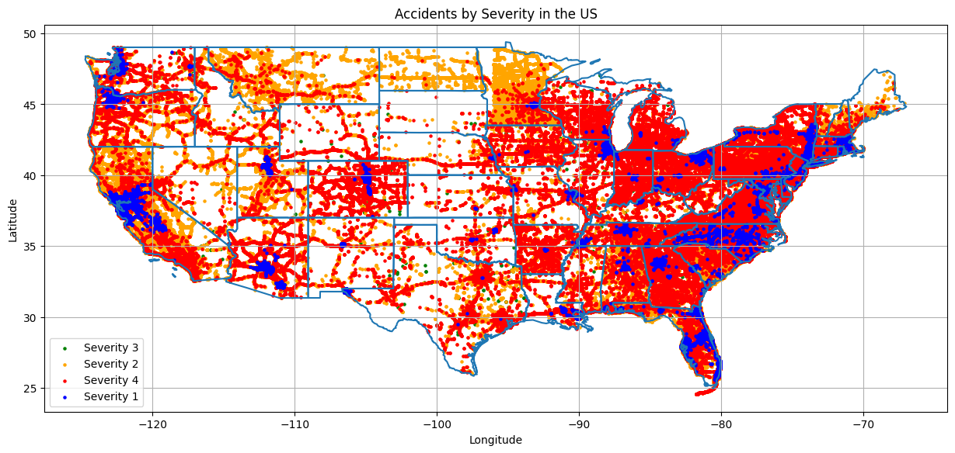

Slide 9
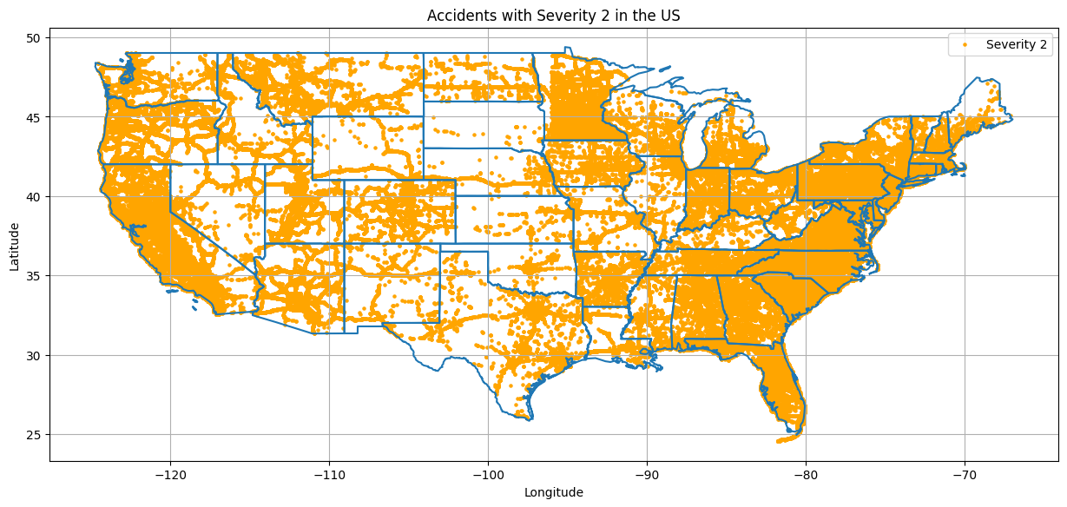
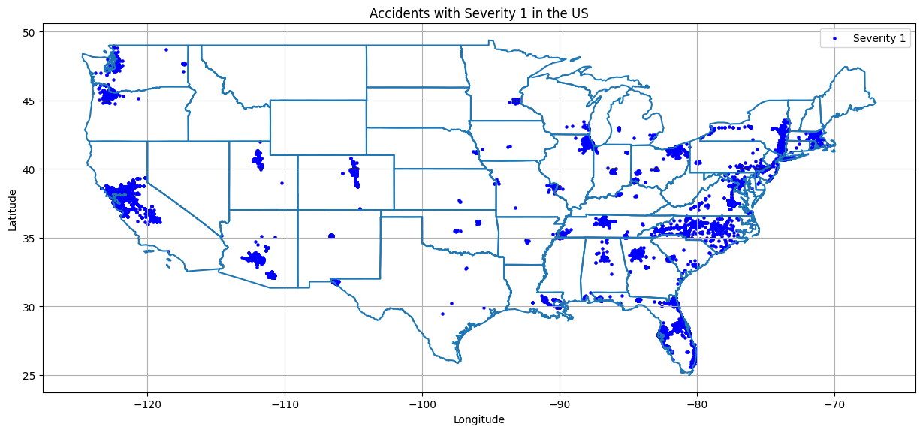
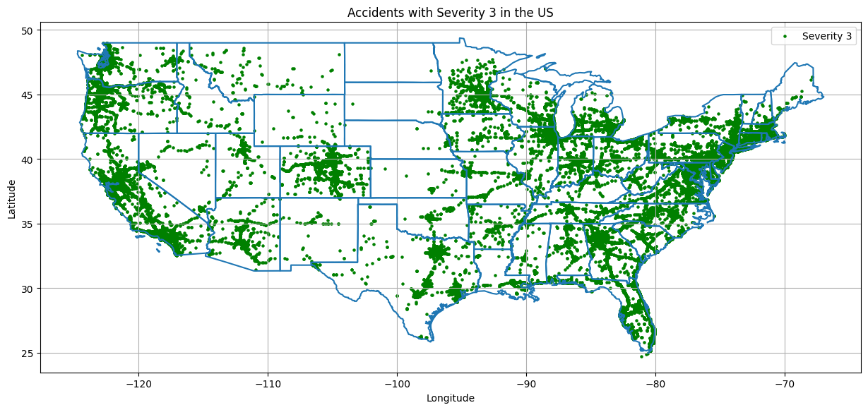
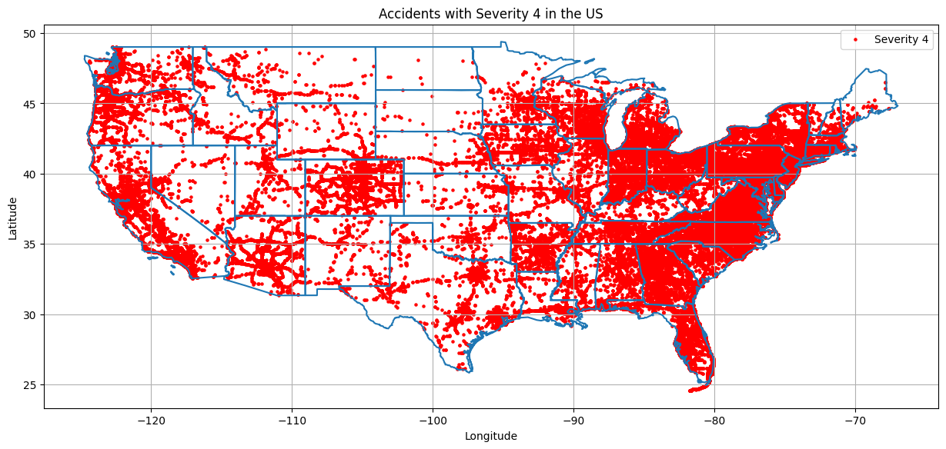

Slide 10
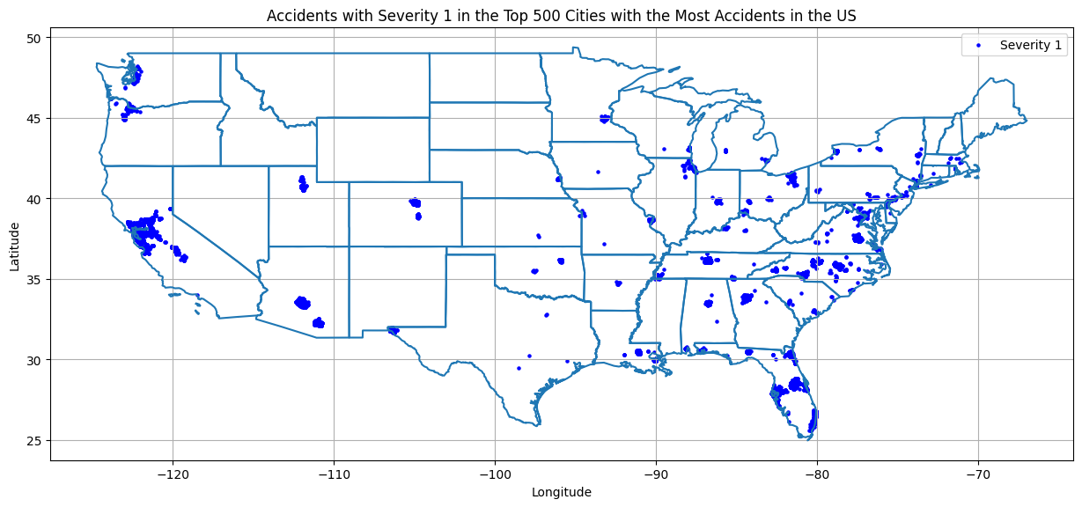
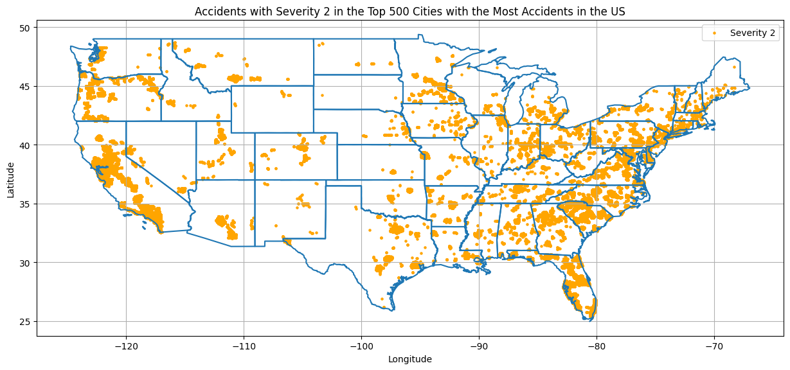
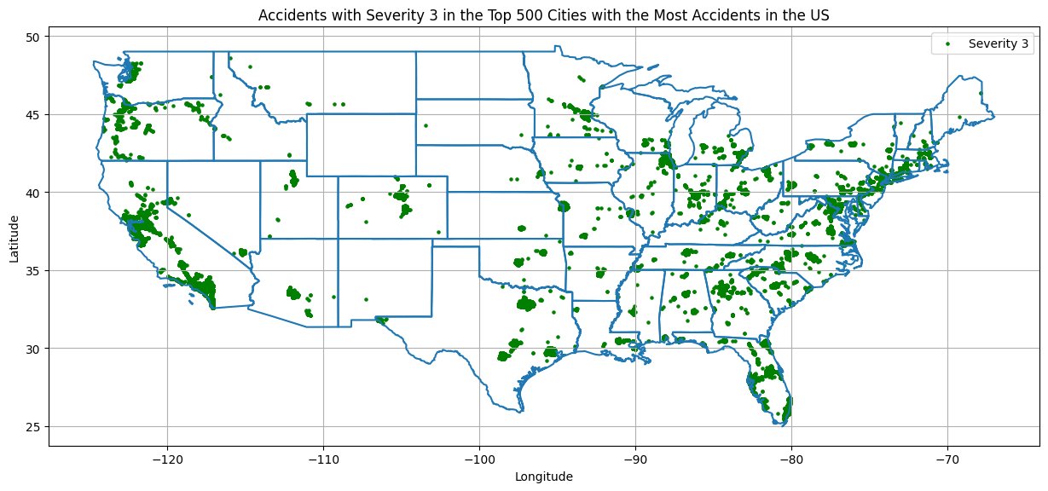
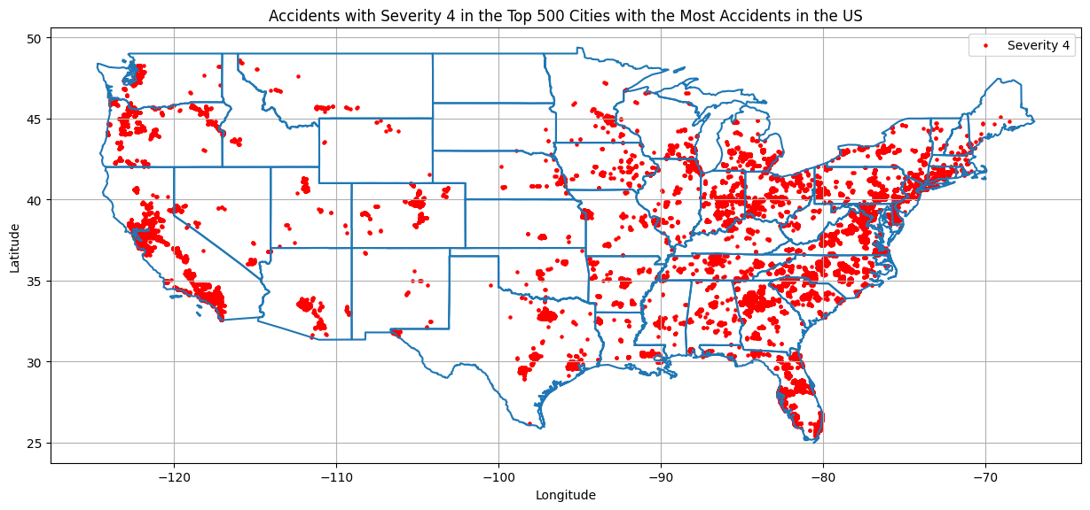
Accidents with Severity {severity} in the Top 500 Cities with the Most Accidents in the US'

Slide 11
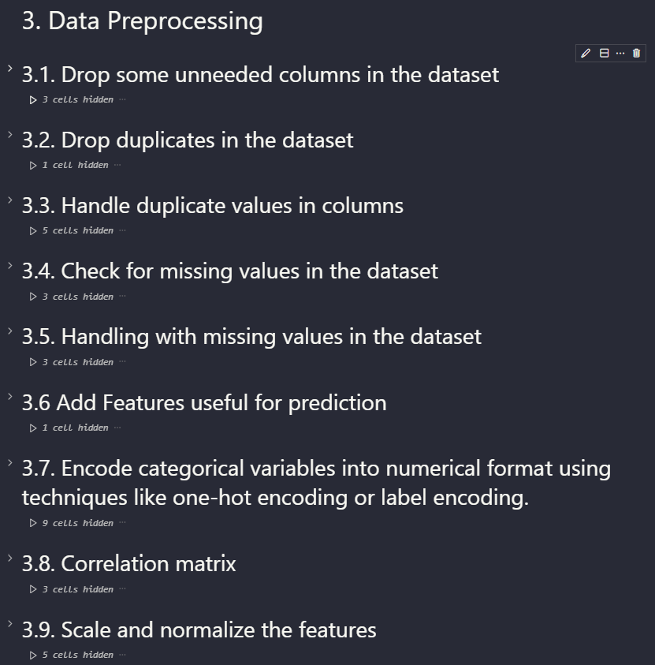

Slide 12
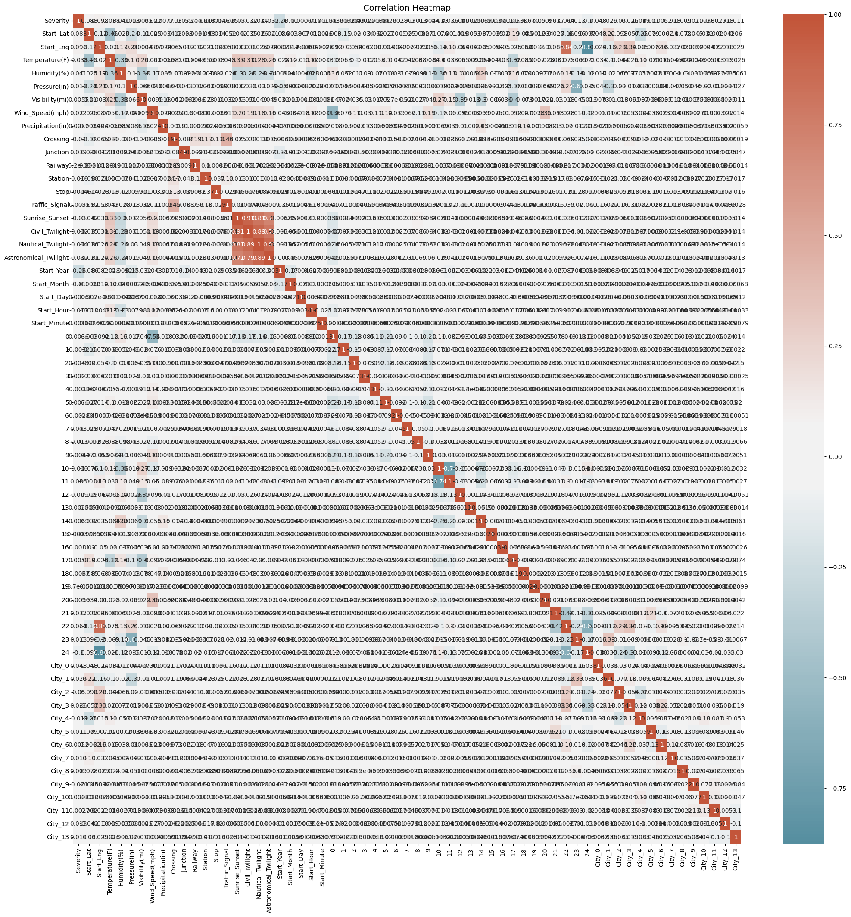

Slide 13
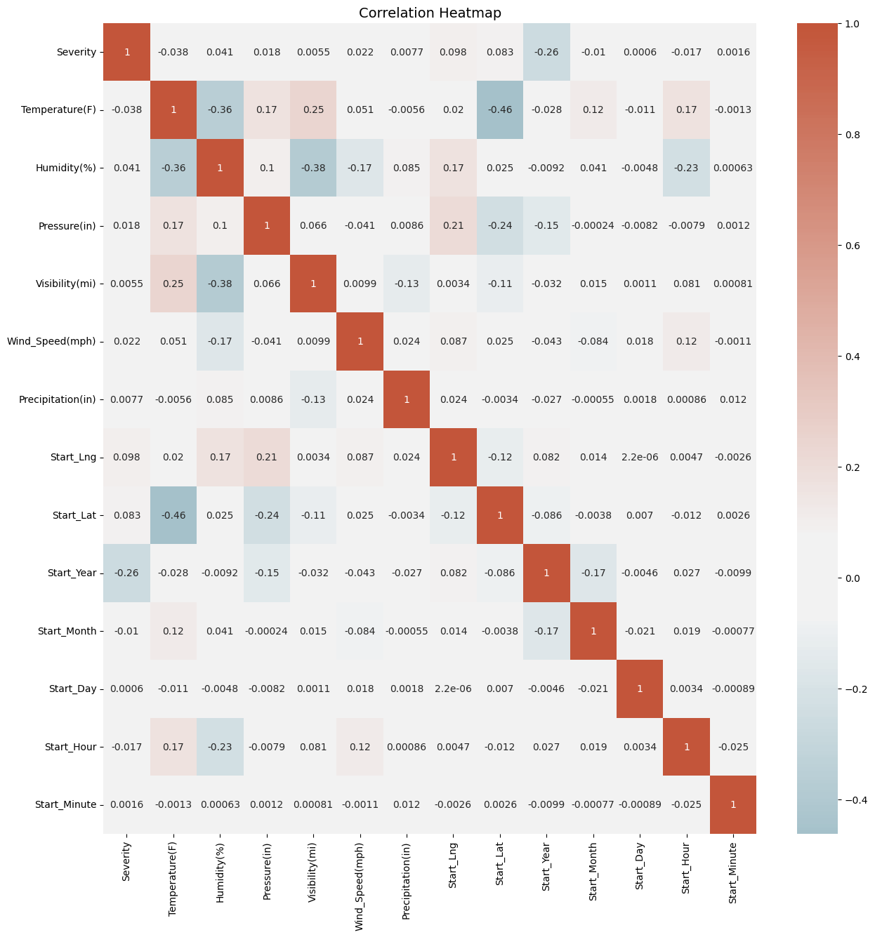
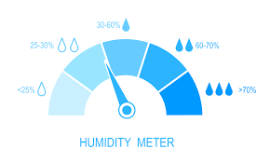
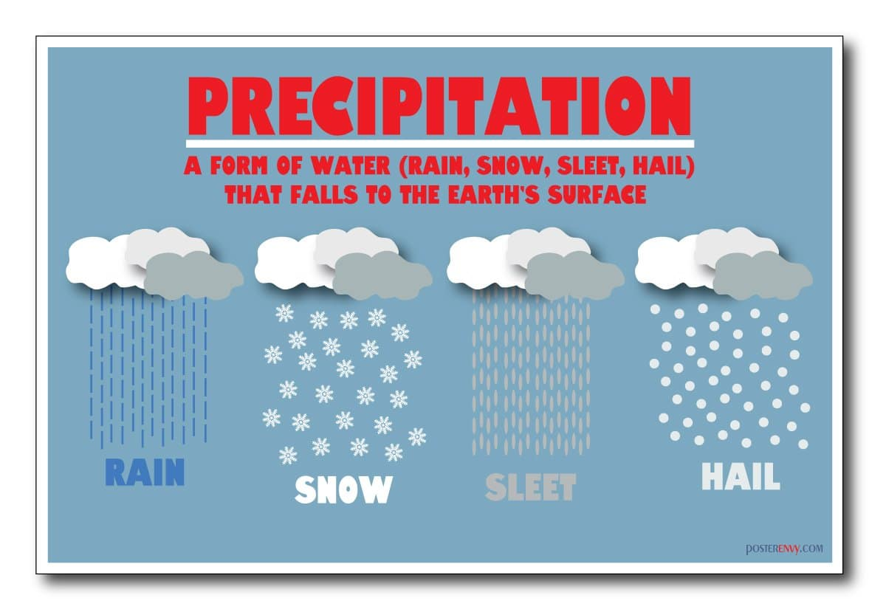

Slide 14
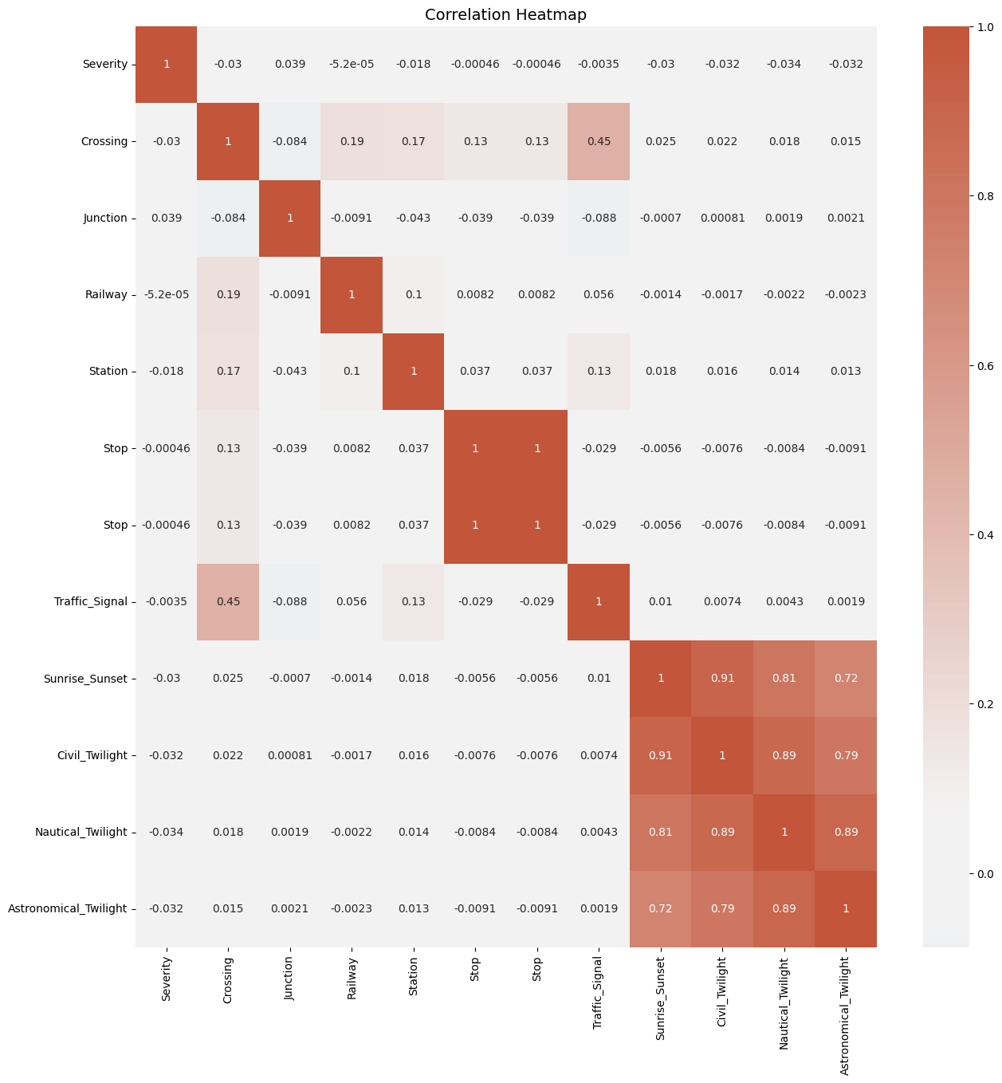
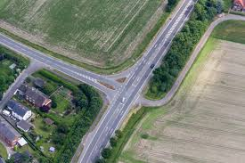
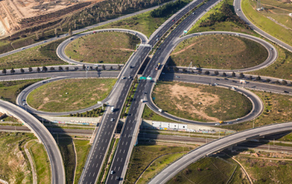
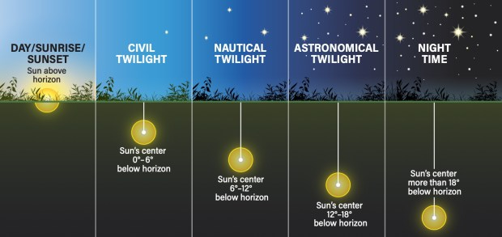
Road junction

Slide 15
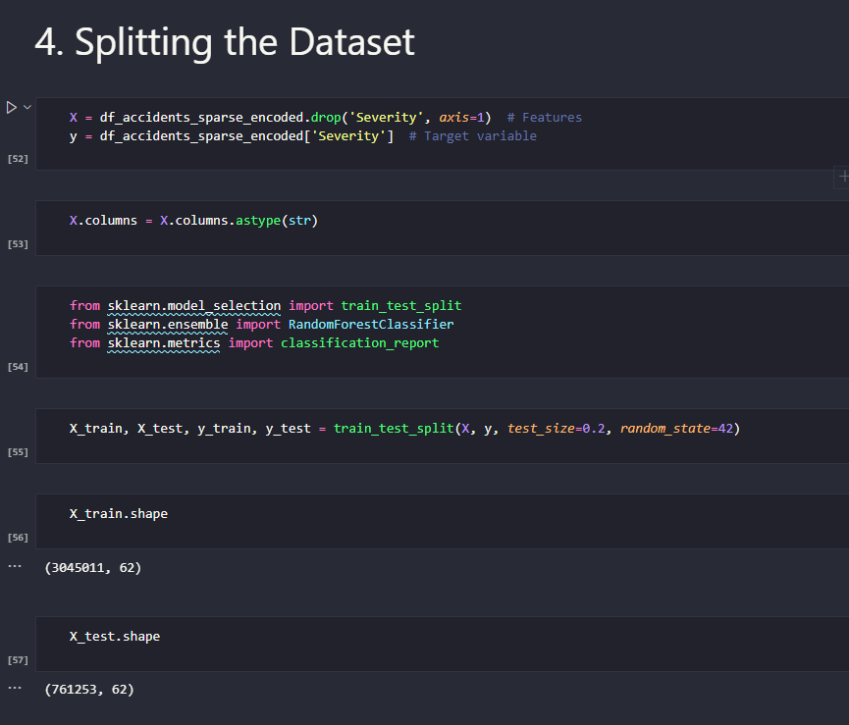

Slide 16
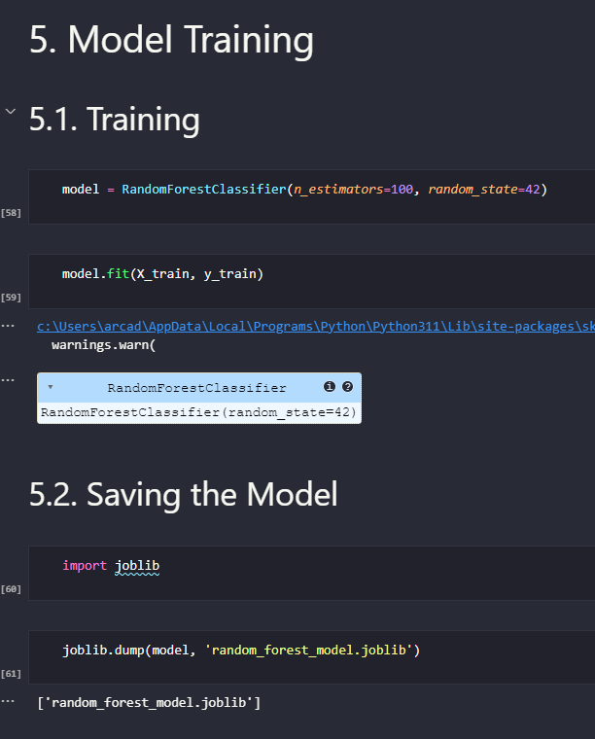

Slide 17

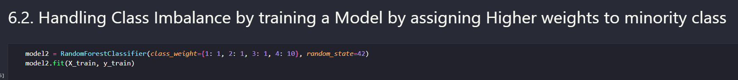
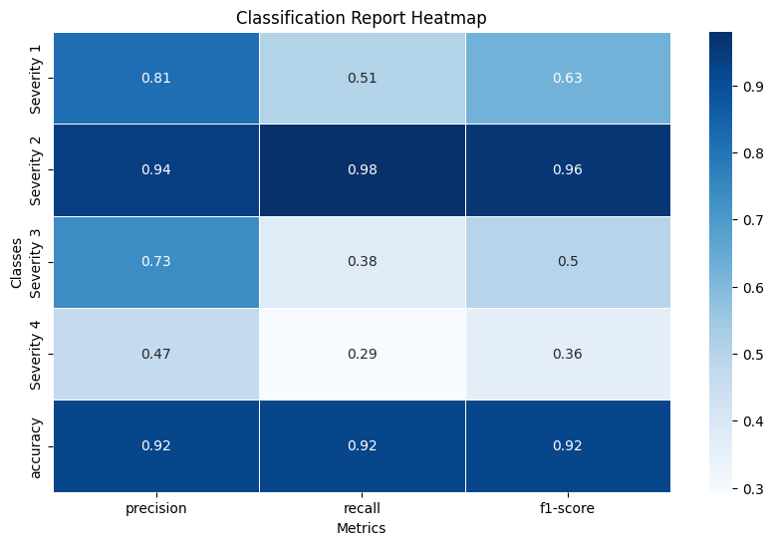
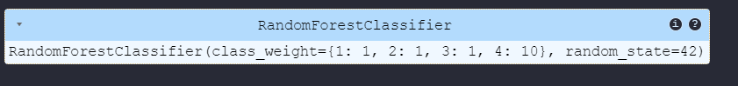
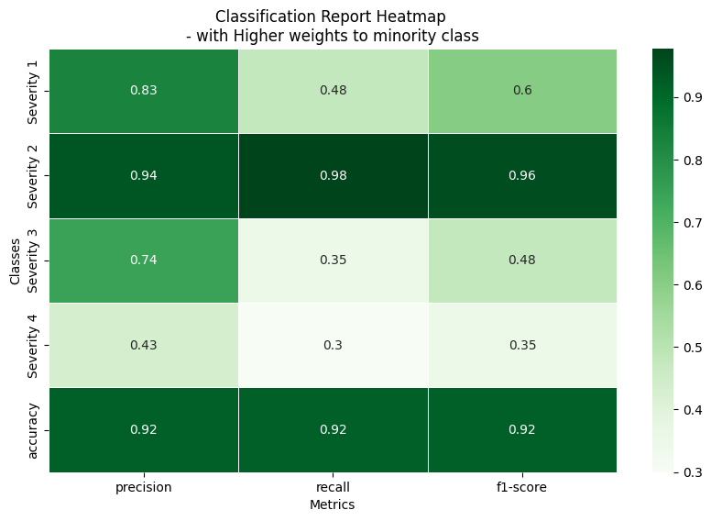

Slide 18
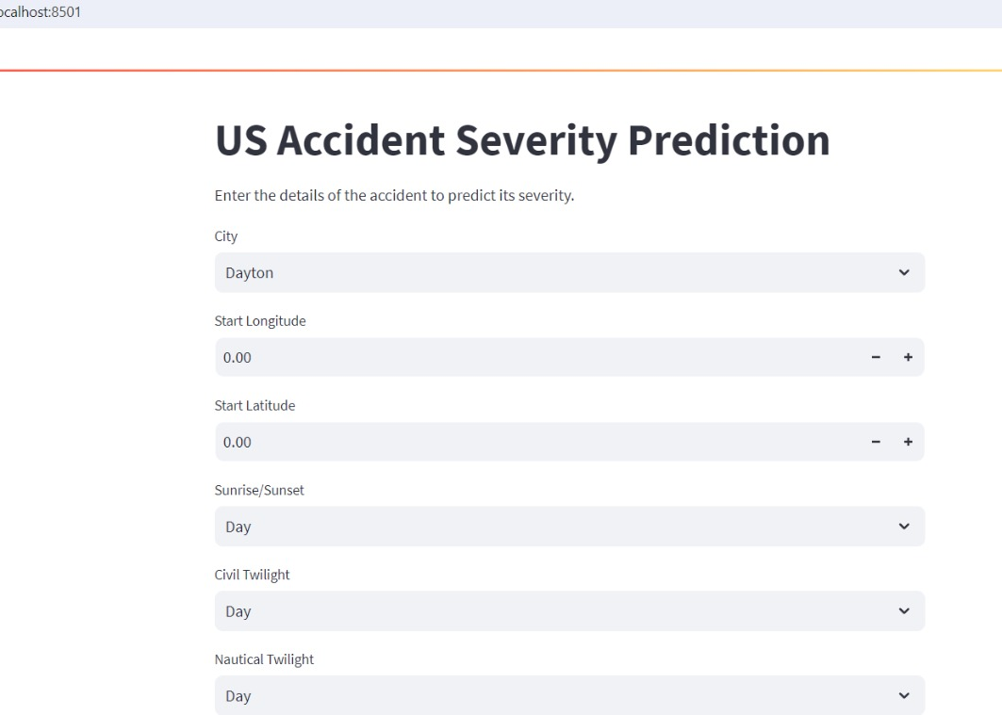

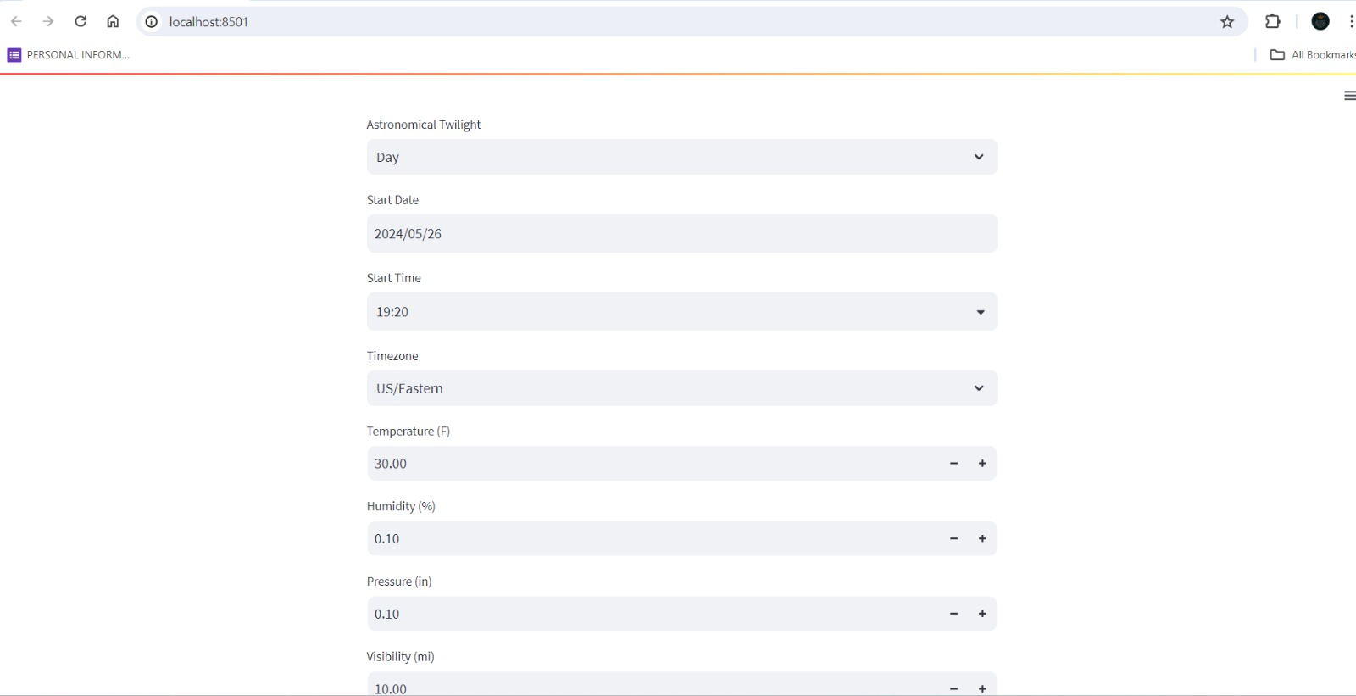

Slide 19
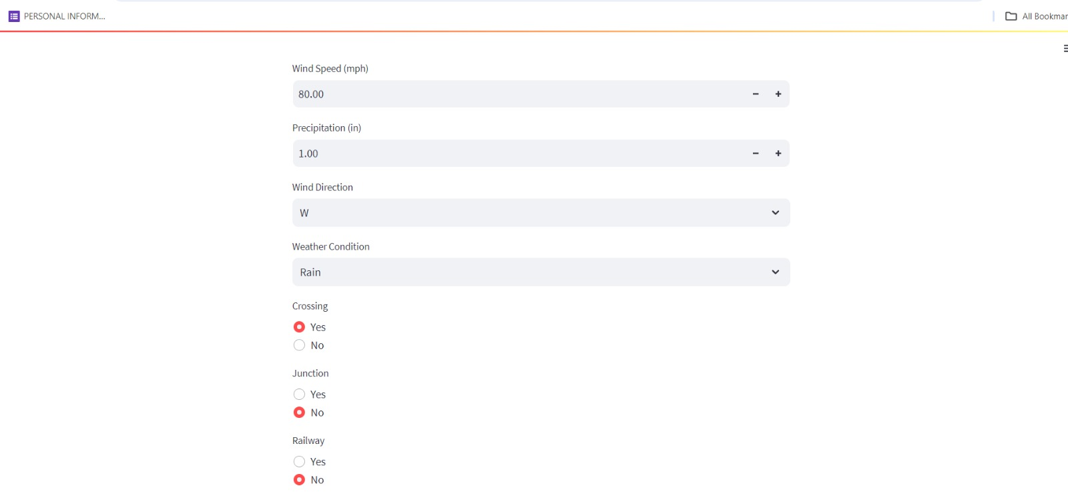
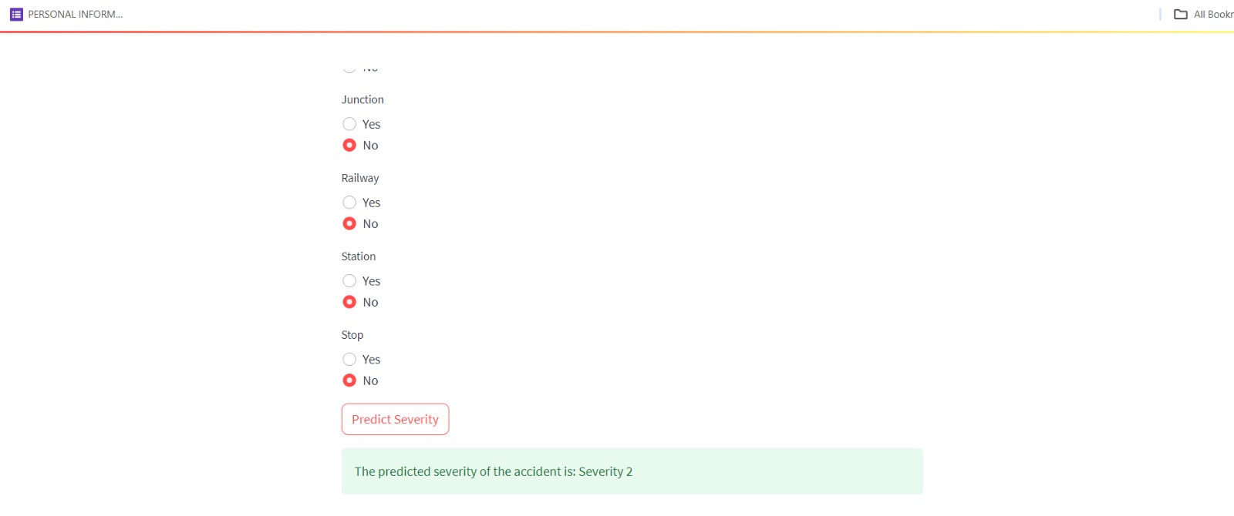

Slide 20

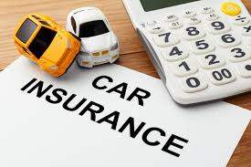
In 2022, property and casualty insurance premiums written in the United States amounted to 715.9 billion U.S. dollars, while life and annuity premiums stood at 635.7 billion U.S. dollars.
A total of 42,939 people died in motor vehicle crashes in 2021. The U.S. Department of Transportation's most recent estimate of the annual economic cost of crashes is $340 billion.
https://www.statista.com/statistics/1102810/insurance-market-size-usa-by-type/
https://www.iihs.org/topics/fatality-statistics/detail/yearly-snapshot

Slide 21
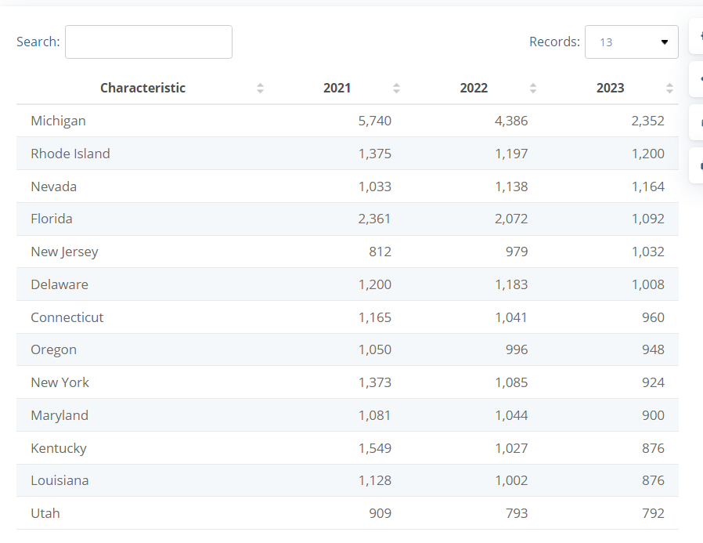
Nevada →
factors responsible increased premiums include inflation and the increased costs for repairs and parts, and more drivers in Nevada engaging in riskier behavior behind the wheel.
Labor shortage
Estimated annual car insurance premiums in the United States from 2021 to 2023, by state(in U.S. dollars)
Why it varies state by state
The huge variance in premiums between states is due to the difference in state laws, the percentage of uninsured drivers in the state, the frequency of natural disasters and claim rates. For instance, Michigan has a no-fault car insurance system, which means that claims are more common. This drives up the cost of insurance for all drivers, because insurers need to pay out more money in claims.
https://www.statista.com/statistics/675367/annual-auto-insurance-premiums-usa-by-state/

Slide 22

Thank you for your attention.
Any questions?

